Slide 1
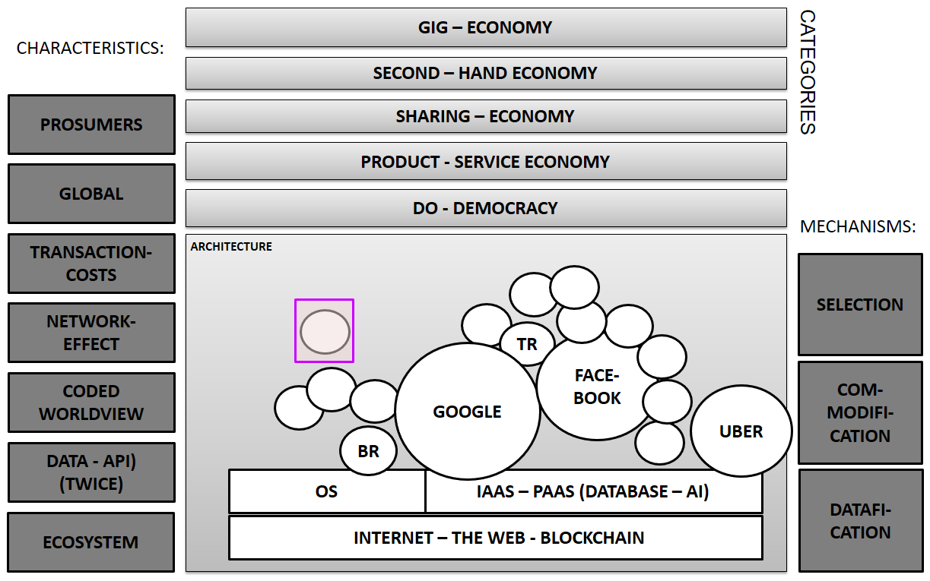
www.technofilosofie.com / www.tict.io

